Slide 1

AgroConnect – The Farmers Marketplace Platform
Presented by: Priyanshu Mishra, Saksham Kumar
Mentor: Dr. Nagendra Nath Dubey

Slide 2


Problem Identification, Originality & Social Relevance
Farmers are often caught in exploitative supply chains, typically retaining only 25–30% of the final product value. This severe disparity is not merely a financial inconvenience but a systemic issue fueled by a critical lack of direct market access, opaque pricing mechanisms, and unreliable quality assurance. The perishable nature of fresh produce, coupled with limited access to storage facilities and real-time market information, makes farmers vulnerable to middlemen who dictate prices and terms, severely impacting their livelihoods and creating significant food waste.
AgroConnect's Originality
Social Relevance
We uniquely integrate an AI-driven grading system for objective quality assessment, dynamic pricing algorithms based on real-time market data, and secure ESCROW payment facilities. This comprehensive approach ensures fair value, optimized pricing, and builds trust for both farmers and buyers.
Our platform empowers farmers by eliminating intermediaries, aiming to double their income and reduce post-harvest waste by up to 60%. This directly contributes to UN Sustainable Development Goal 2: Zero Hunger, fostering sustainable food production and improving rural livelihoods.

Slide 3
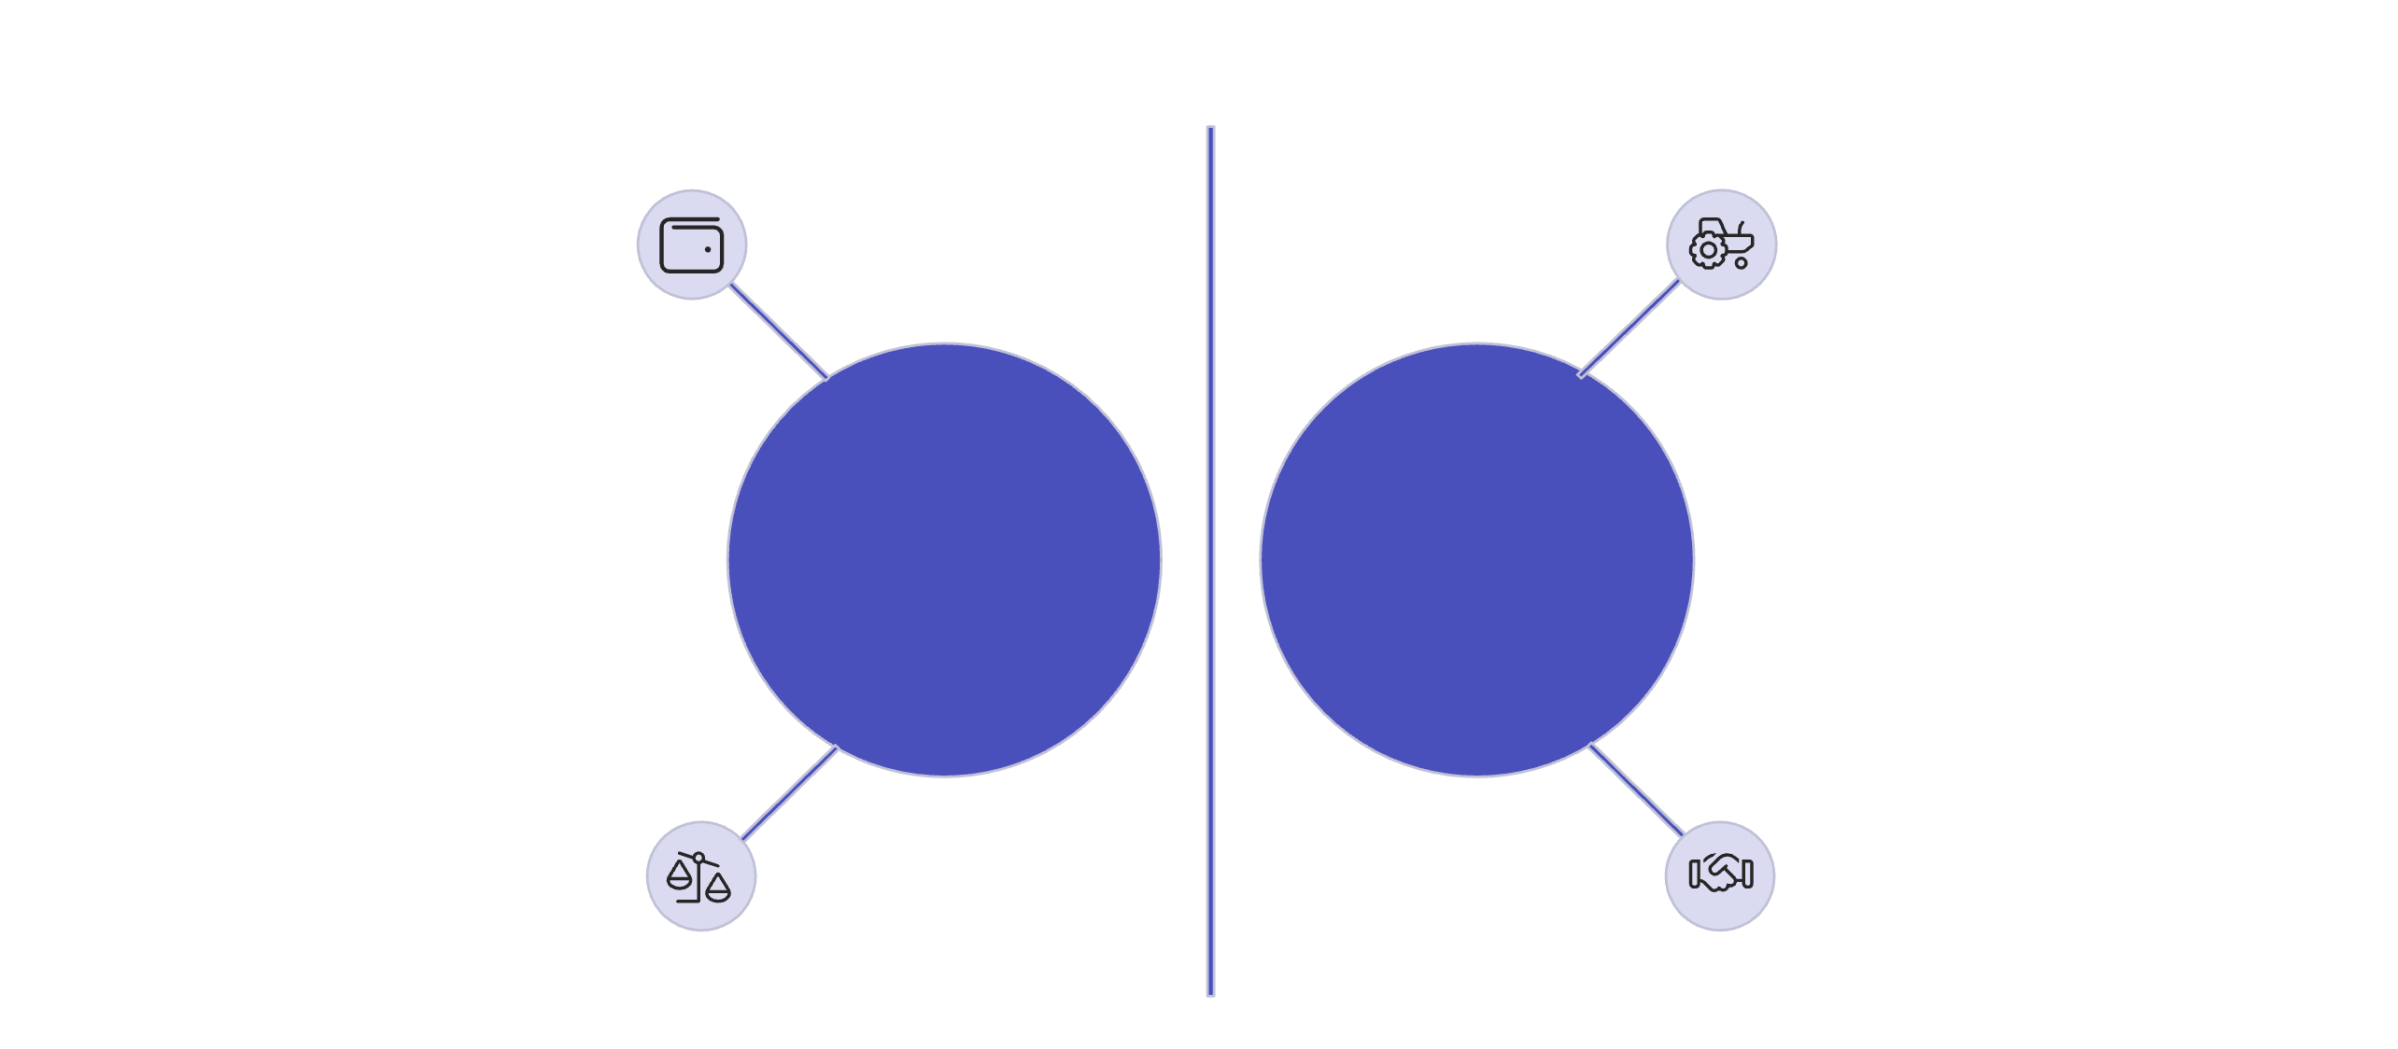




The Need for a Direct Marketplace
Farmers often receive a disproportionately small share of the final sale price of their produce, typically earning only 25–30% due to multiple layers of intermediaries. This limited market access reduces their sales potential and forces them to contend with unfair pricing and inadequate quality verification mechanisms.
Consumer pays full price
Farmer receives small share
Multiple Intermediaries
Direct Marketplace
Intermediary fees reduce amount
Consumer pays, more to farmer
A direct marketplace mitigates these issues by fostering transparency, enabling farmers to secure better profits, and giving them greater control over their sales process.

Slide 4
Bridging the Market Gap
Current Market Problems
AgroConnect's Solutions
Complex Interfaces
Simple, Multilingual UI
Many existing platforms feature overly complex user interfaces that lack essential functionalities, hindering adoption by farmers.
An intuitive interface in multiple local languages ensures accessibility for all farmers.
Lack of Trust
Hassle-Free Financial Access
A significant trust deficit exists in current digital agricultural marketplaces, particularly concerning payment security and product quality.
Facilitating easy access to loans and secure ESCROW payments builds critical trust.
Integrated AI Tools
Untapped Potential
Features like AI-driven crop disease detection and streamlined access to farming equipment directly address key pain points, eliminating intermediaries.
The full potential of integrating advanced technology for farmer empowerment remains largely unexplored.

Slide 5
Literature Survey / Related Work
e-NAM (India): Provides market data only; lacks payment and quality verification.
Integrated solution with AI quality checks, dynamic pricing, and secure payments.
iCow (Kenya), FarmCrowdy (Nigeria): No successes and limited scalability beyond specific regions.
Designed for scalability and global reach, adaptable to diverse agricultural ecosystems.
FBN (USA), AgriDigital (Australia): Primarily cater to large-scale commercial farms, excluding smallholders.
Specifically designed to empower small and medium-sized farmers, improving their market access.
The market currently lacks a platform that seamlessly integrates AI-driven quality assurance, dynamic pricing, secure payments, and end-to-end logistics. AgroConnect is uniquely positioned to fill this critical gap, providing a comprehensive solution for agricultural trade.

Slide 6



Technical Approach & AI Methodology
Quality Verification
Dynamic Pricing
Utilizing MobileNet and TensorFlow Lite for efficient, on-device AI-powered quality assessment of produce.
A sophisticated formula combining e-NAM data, quality scores, market demand, and seasonality to ensure fair and competitive pricing.
Fraud Detection
Architecture & Logistics
Employing Random Forest algorithms with SHAP (SHapley Additive exPlanations) for robust and transparent fraud detection.
Built on a MERN stack PWA (Progressive Web App), integrated with Mapbox API for optimized mapping and delivery logistics.

Slide 7
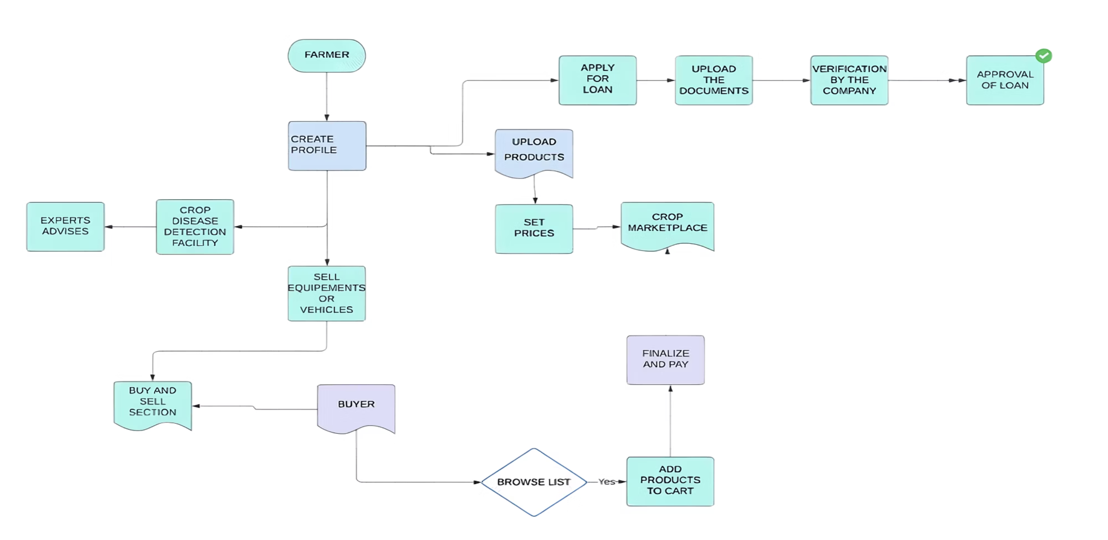
AgroConnect System Flow
Our streamlined system ensures transparency and efficiency from farm to table, leveraging AI and secure payment mechanisms.

Slide 8
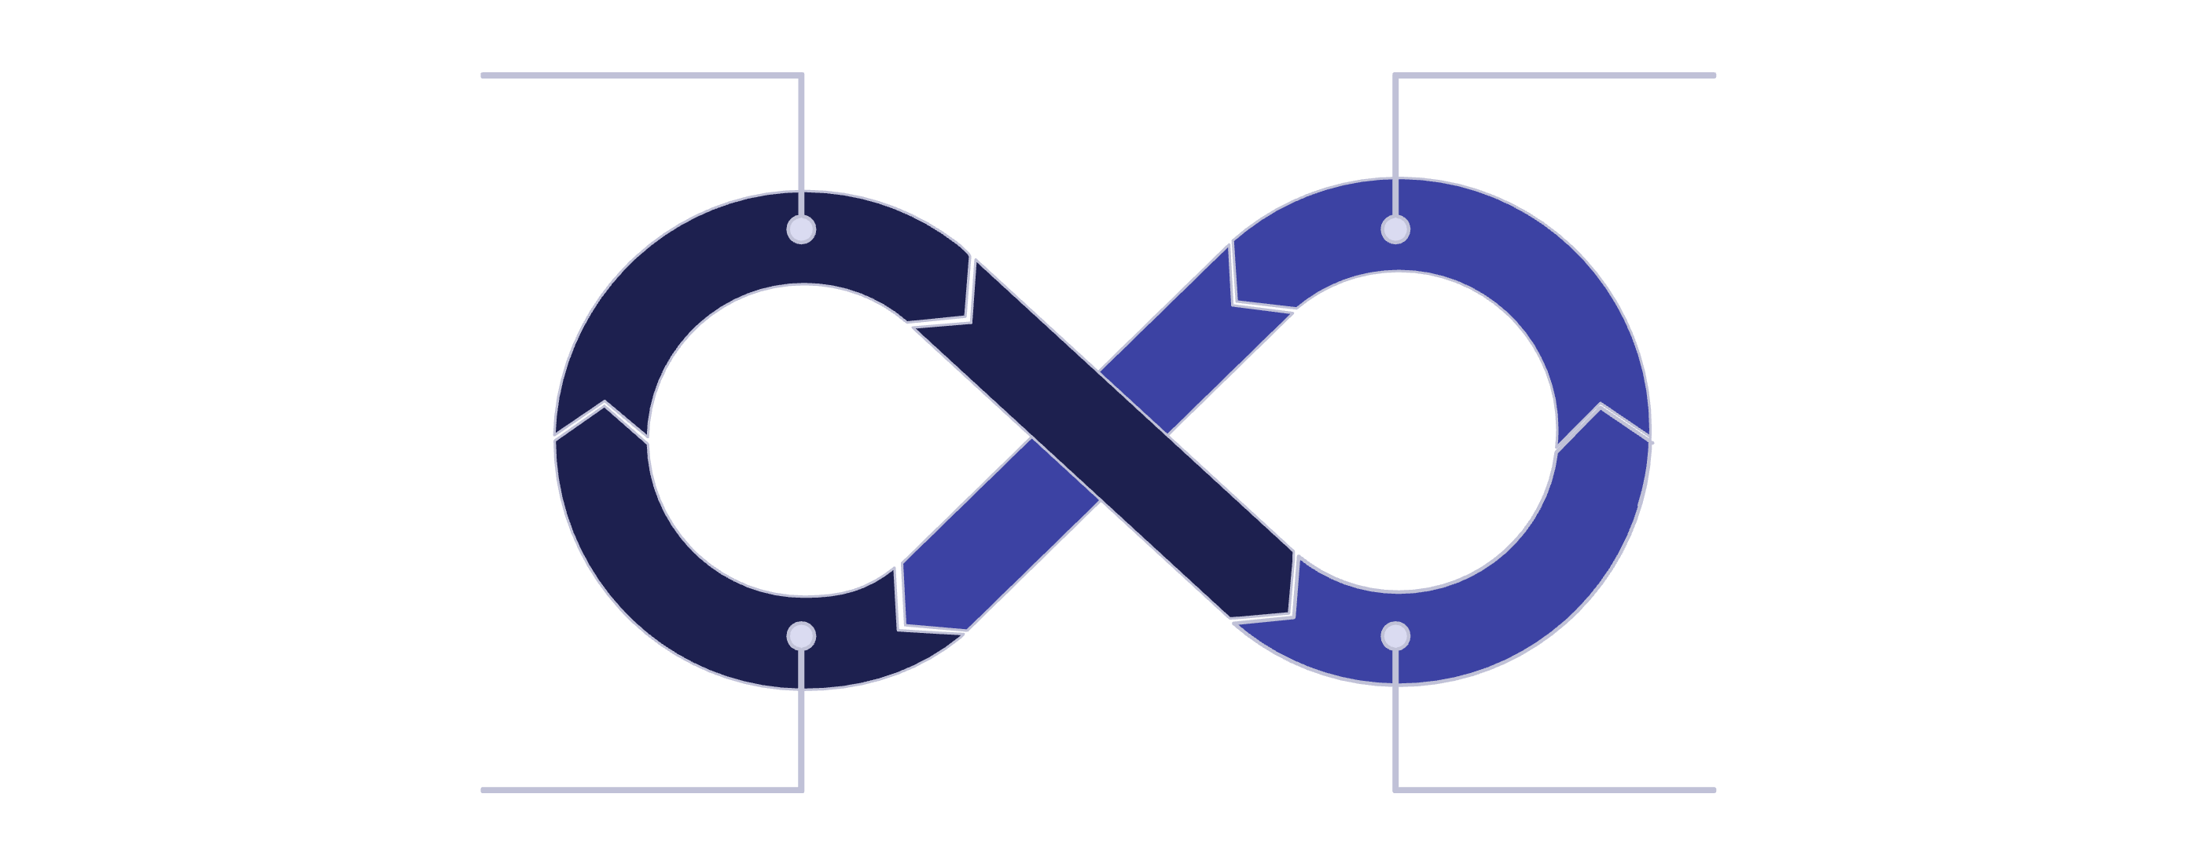
Business Model: Driving Value Through Commission
Farmers sell on AgroConnect
AgroConnect takes commission
Buyers get fair prices
Farmers earn higher profits
Our revenue model is built on a transparent commission structure, where AgroConnect takes a small percentage from each successful sale. This model aligns our success directly with the prosperity of our users.
Farmers Benefit: Enjoy higher profits due to reduced intermediary costs and secure, transparent transactions.
Consumers Benefit: Access competitively priced, high-quality produce with guaranteed authenticity.

Slide 9








Mutual Benefits: Farmers & Buyers
For Farmers
For Buyers
Higher Income
Fresh Produce
Direct sales translate to a larger share of the profit, improving livelihoods.
Direct sourcing ensures fresher, higher-quality agricultural products.
Transparency
Competitive Pricing
Clear pricing and quality standards foster trust and fair trade practices.
Reduced intermediary costs lead to more affordable prices.
Bulk Sales
Direct Communication
Access to a wider buyer base enables larger volume transactions.
Ability to connect directly with farmers for specific needs or inquiries.
Inventory Management
Trust in Sourcing
Tools to efficiently track and manage produce availability.
Verified quality and transparent origins build confidence in purchases.

Slide 10

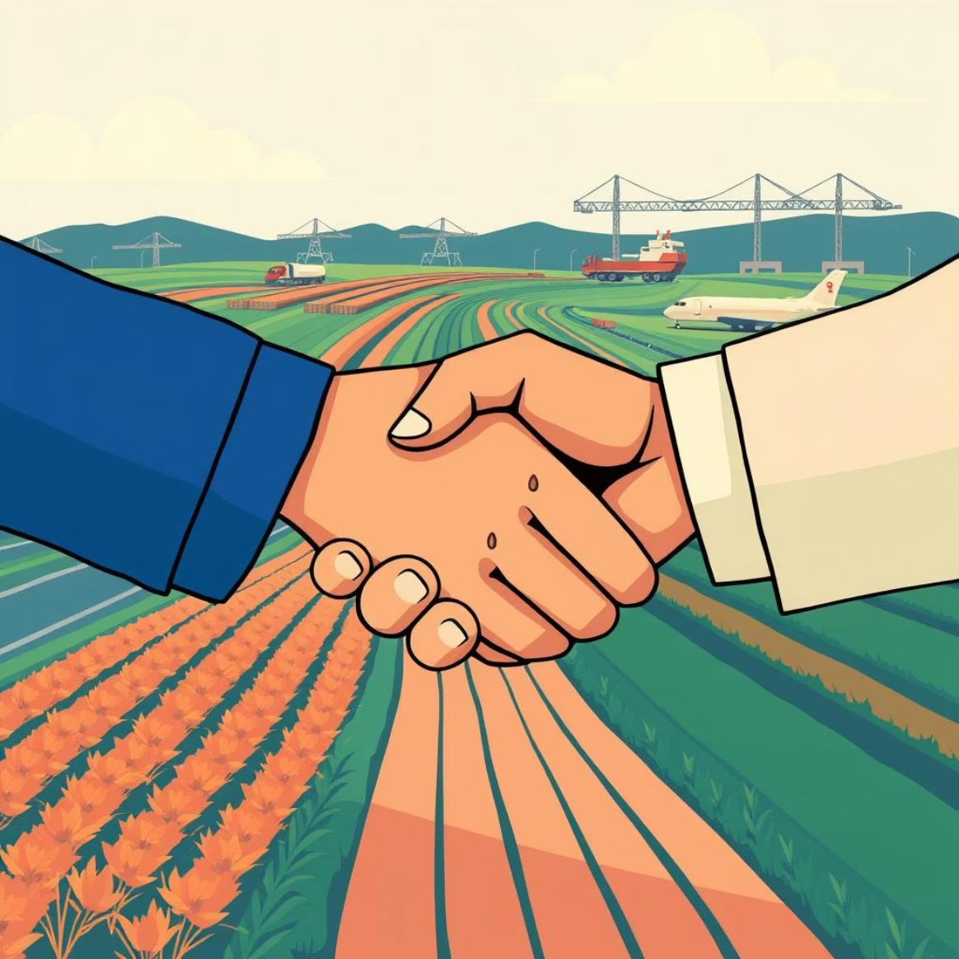
Marketing Strategy
Social Media Campaigns
Strategic Partnerships
Engaging campaigns on platforms like Facebook and Instagram will target both farmers and buyers, showcasing success stories and the benefits of AgroConnect.
Collaborations with local agricultural cooperatives, NGOs, and established logistics providers will expand our reach and build community trust.
Our multi-pronged marketing approach combines digital outreach with grassroots partnerships to maximise platform adoption and user engagement.

Slide 11
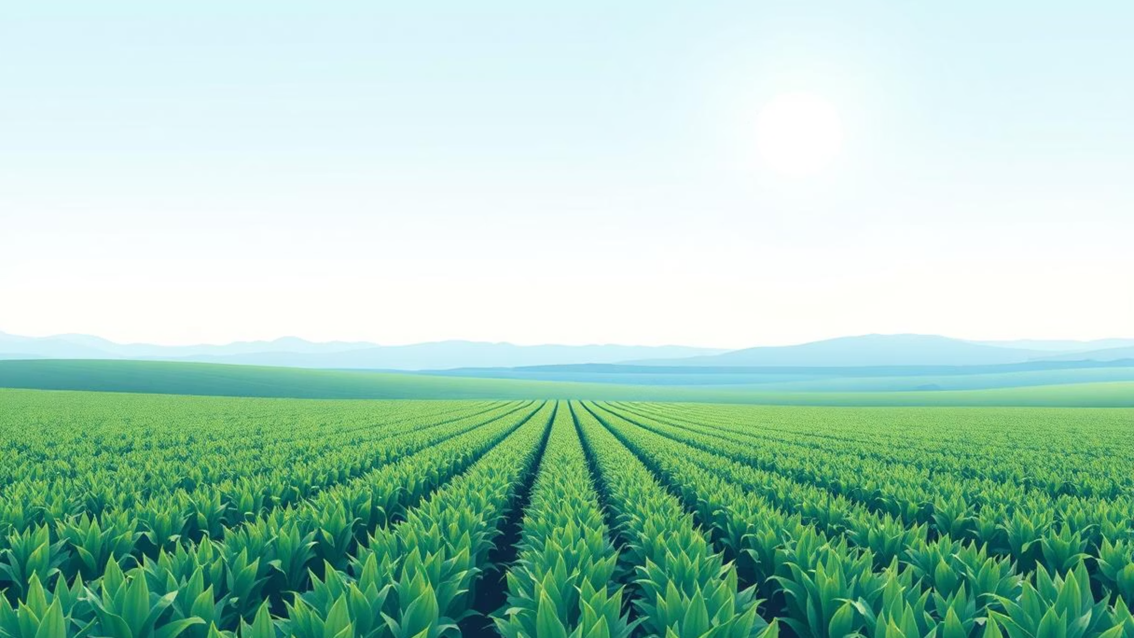
Thank You

